Slide 1

Teams 5, 8, 12
Fortune cookies
Sharon, Jackie, Fengxia, Wenhui (Vivian), Pallavi
Kaesha, Chrystinne, Chad, Atika, João Emory Datathon 2023

Slide 2
Live Dashboard

Slide 3
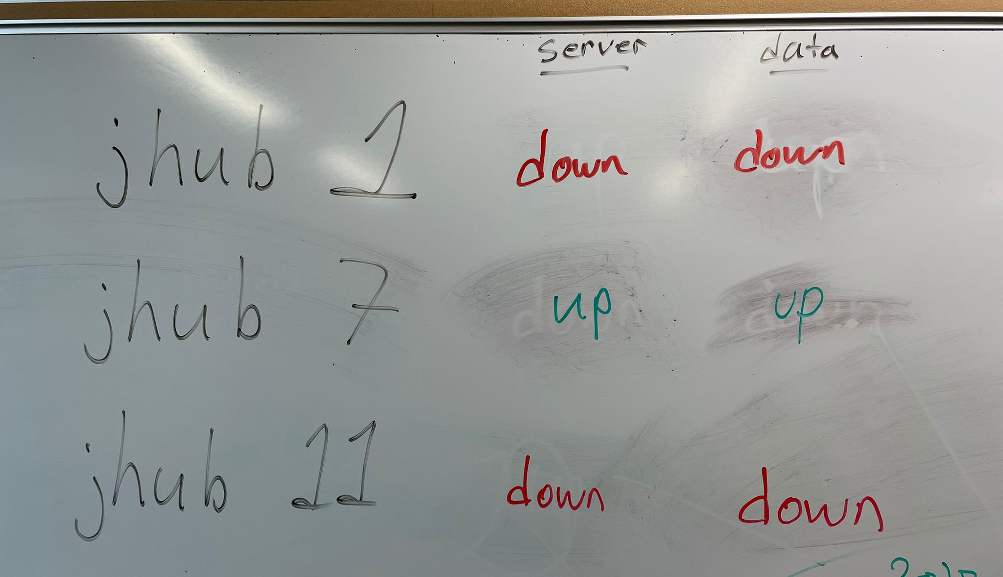
So we tried to analyze data…

Slide 4
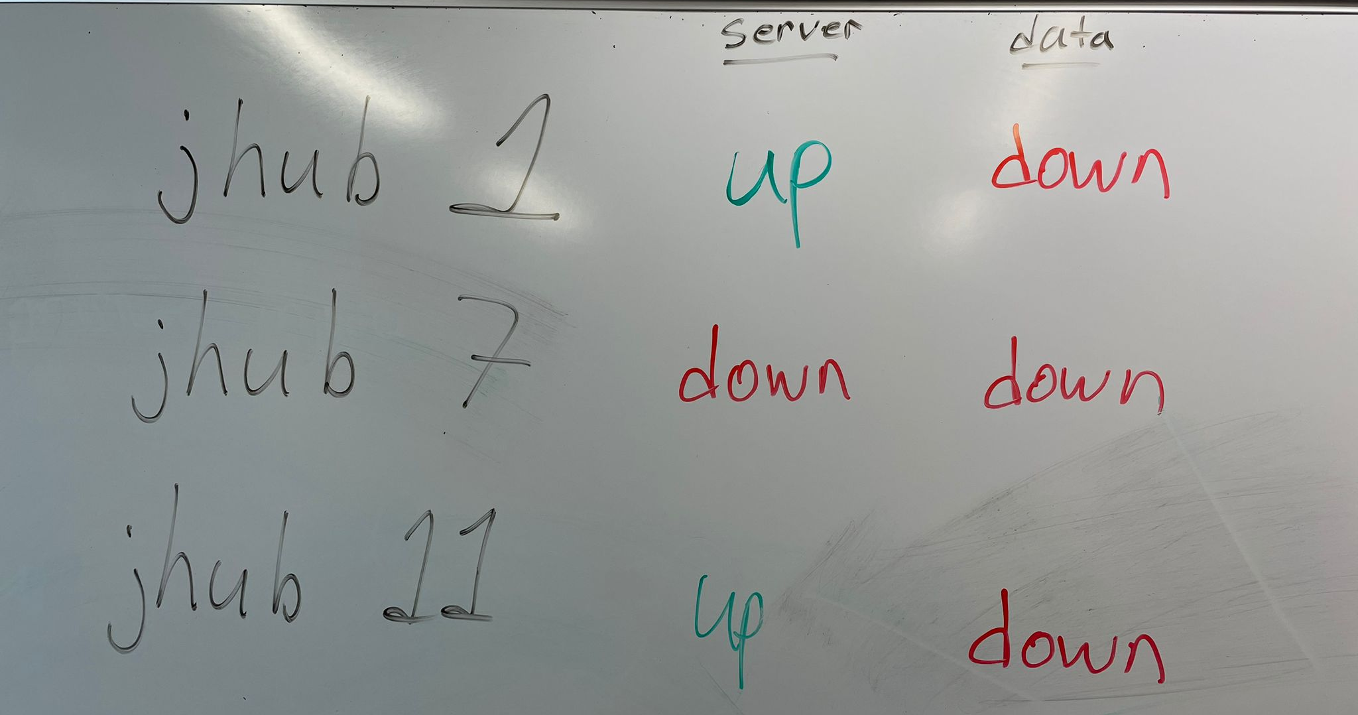
So we tried to analyze data…

Slide 5
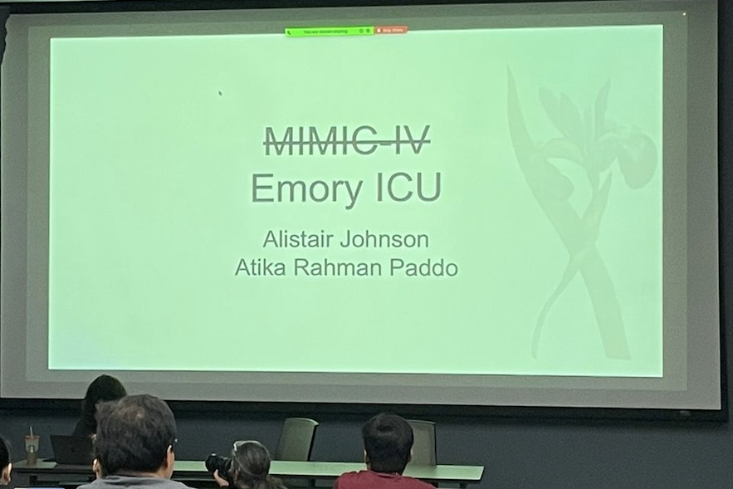
Our Dataset
MIMIC-IV

Slide 6
Research Question
Are there disparities in the use of pressure reducing devices to prevent and treat pressure injuries in the ICU?

Slide 7
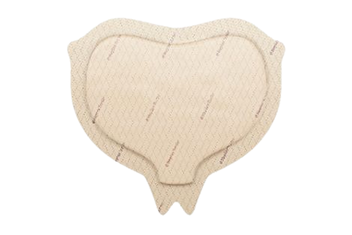
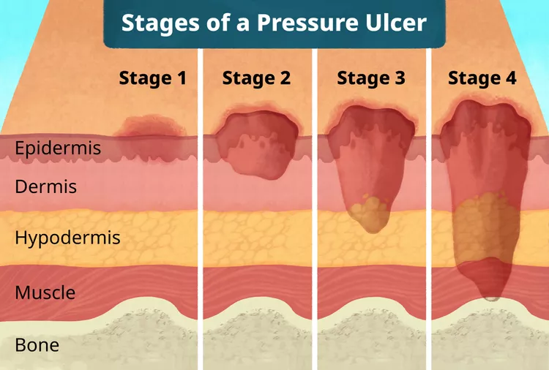
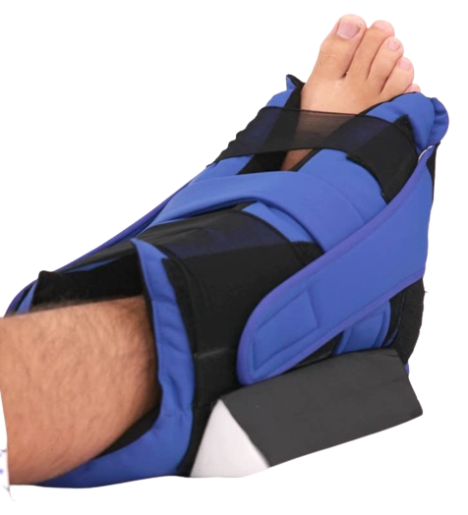
Problem Statement

Slide 8
Here’s what we did with the Emory Dataset!
The initial goal was to find disparities in the Emory ICU data.
Based on what? Race? Age? Gender?
Here’s what we did….
We found the disparities among the…
Hospitals!!!!

Slide 9
5 Hospitals under Emory…
Emory University Hospital (EUH)
Emory St. Joseph Hospital (SJH)
Emory University Hospital Midtown (ECLH- old name)
Emory Johns Creek Hospital (EJCH)
Emory Orthopedic & Spine Hospital (NL- old name)

Slide 10
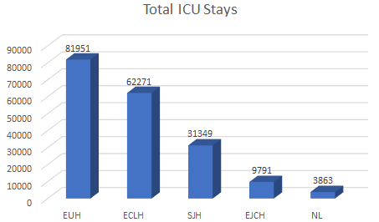
Total Number of ICU Stays
Emory University Hospital- Home of Research (More patients coming in);
ECLH (Emory Crawford Long Hospital, currently Midtown)- Urban Hospital;
SJH (Sub-urban hospital)
EJCH, NL (Sub-urban hospital)
P(More patients coming in) ⬄ P(More Pressure Injuries)

Slide 11
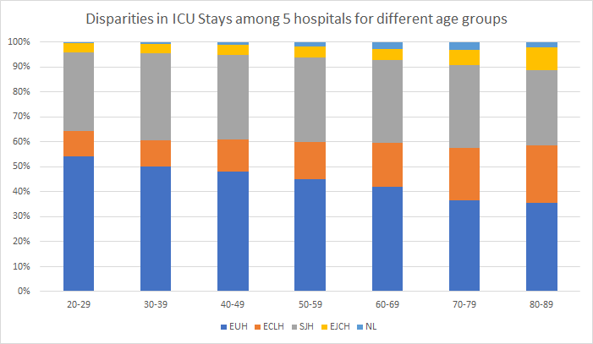
Different Age Groups
ECLH tends to get more older patients
= Increases the chance of pressure injuries
*Mondragon N, Zito PM. Pressure Injury. 2022 Aug 25. In: StatPearls [Internet]. Treasure Island (FL): StatPearls Publishing; 2023 Jan–. PMID: 32491791.

Slide 12
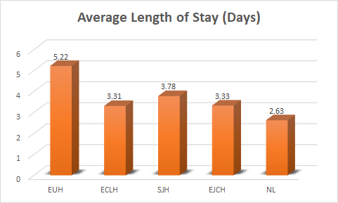
Average Length of Stays in ICU (Excluding the Outliers)
After 4 days of stay in the ICU for an acute ill patient, pressure injury can occur;
EUH is more likely to get patients from ICU developing pressure injuries;
Some patients were found to be in ICU for months. Those are considered as outliers (using 3-SD method) and removed.
Padula WV, Delarmente BA. The national cost of hospital-acquired pressure injuries in the United States. Int Wound J. 2019 Jun;16(3):634-640. doi: 10.1111/iwj.13071. Epub 2019 Jan 28. PMID: 30693644; PMCID: PMC7948545.

Slide 13
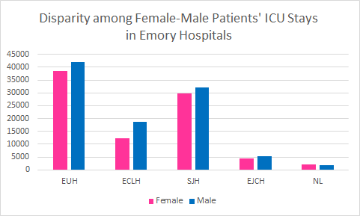
Number of ICU stays of different gender groups
Men have a slightly higher chance than women to develop pressure surgeries.
The Emory hospitals (except the Orthopedic & Spine Hospital) have shown men have larger number of ICU stays, thus possibility of higher chance of developing pressure injury.
Lichterfeld-Kottner A, Lahmann N, Kottner J. Sex-specific differences in prevention and treatment of institutional-acquired pressure ulcers in hospitals and nursing homes. J Tissue Viability. 2020 Aug;29(3):204-210. doi: 10.1016/j.jtv.2020.05.001. Epub 2020 May 13. PMID: 32471633.

Slide 14
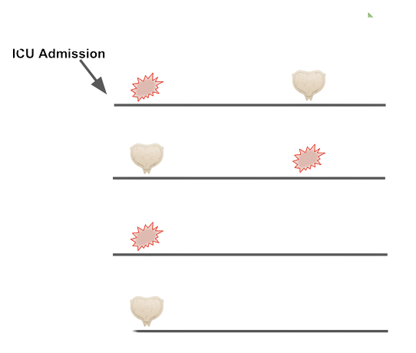
4 Treatment Scenarios
ulcer
device
ICU Discharge
01
Treatment
02
Prophylaxis, Failure
03
No Prophylaxis, Failure
04
Prophylaxis Success

Slide 15
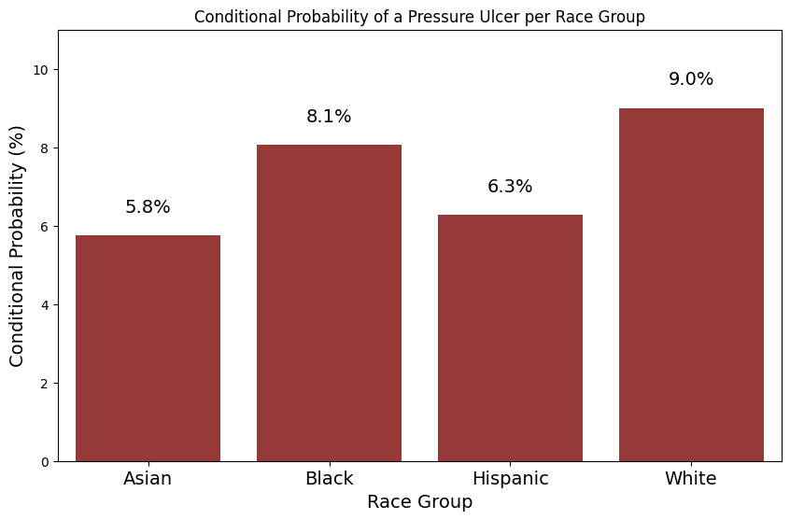
We extracted the data from MIMIC-IV
Any pressure ulcer of any stage during the stay →
Notes:
Including Stage 1 PrI

Slide 16
POP QUIZ!
Probability of Getting at Least ONE Pressure Device by Race
29.0%
26.8%
25.9%
24.2%

Slide 17
POP QUIZ!
Probability of Getting at Least ONE Pressure Device by Race
White
Asian
Black
Hispanic
29.0%
26.8%
25.9%
24.2%

Slide 18
In what cases are the disparities occurring?
 | Black | White | P-Value
n | 7960 | 49891
Prophylaxis Success, n (%) | 1645 (20.7) | 11488 (23.0) | <0.001
Treatment, n (%) | 181 (2.3) | 1455 (2.9) | 0.001
No Prophylaxis, Failure, n (%) | 224 (2.8) | 1509 (3.0) | 0.323
Age, median [Q1,Q3] | 63.0 [51.0,74.0] | 68.0 [56.0,79.0] | <0.001

Slide 19
Future Directions
Apply these queries to Emory ICU
Adjust for relevant confounders
Age, comorbidities, other treatments?
Facilities’ differences contribute to differences in prevention and treatment? And how to make health care delivery consistent.
Data accuracy / improvement opportunity: How can we better detect Stage I PrI in Black patients? (Data may indicate more Stage I in White patients)

Slide 20
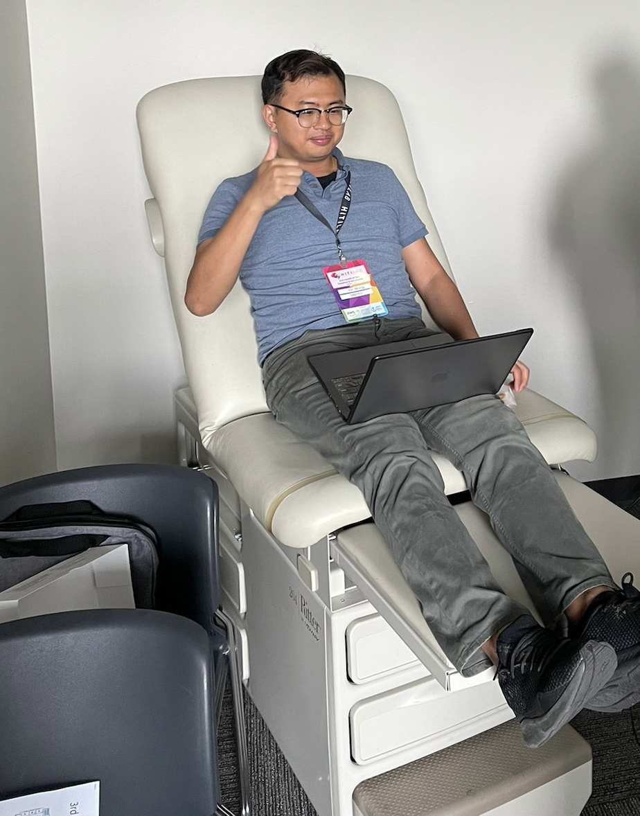
Thank
you!

Slide 21
Summary Slides
Pressure ulcers are a significant issue particularly in ICU patients.
Racial and socioeconomic disparities exists in the development of ulcers in the ICU however these reasons are poorly understood.
By grouping out cohort into 4 distinct groups: prophylactic failure, prophylactic success, no treatment and no treatment we can get a better understanding of the prevention and treatment interventions used and disparities within these subgroups.
We can therefore see which factors can predict placement into these subgroups.
We hypothesize there there will be disproportionately more non Whites in the no treatment and prophylactic failure group.
We hypothesize that the risk of development of ulcers is significantly different among Emory Healthcare Hospitals.
While most of the work was done on the MIMIC-IV dataset, we anticipate similar and more robults results in the Emory ICU dataset due to the diverse dataset.
In the future, we can look at ulcer stage progression in the ICU and disparities that occur in the groups of: ulcer stage throughout admission and stage progression throughout admission.

